Slide 1

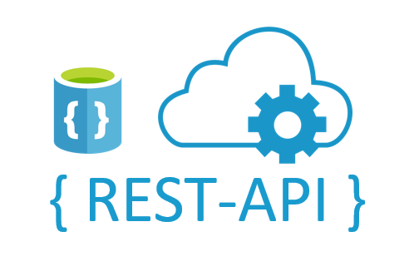
Build a Vulnerable REST API and Conduct Penetration Testing on It
R.Srujana REDDY
AP22110011502
CSE-Y

Slide 2
Project Overview
Create a REST API with intentional vulnerabilities
1
Perform Penetration Testing using crafted payloads
2
Learn how to identify and fix common web application flaws
3
Demonstrate real-world exploitation and secure coding practices

Slide 3

List of Vulnerabilities
SQL Injection
Plaintext Password Storage
Cross-Site Scripting (XSS)
Weak Authentication Mechanism
Predictable Token Generation
Brute Force Vulnerability
Insecure Direct Object Reference (IDOR)
Command Injection (eval)

Slide 4
Flask Code – Walkthrough
@app.route('/test_all_vulnerabilities', methods=['POST'])
This endpoint receives a JSON payload containing fields like username, password, expression, and user_id.
SQL Injection:
vulnerable_query = f"SELECT * FROM users WHERE username='{username}' AND password='{password}'"
This line directly injects user input into SQL query. If someone sends "admin' OR '1'='1", they can bypass authentication.
Plaintext Password Storage:
cursor.execute("INSERT INTO users (username, password) VALUES (?, ?)", ...)
Password is stored as-is, without encryption or hashing.
Cross Site Scripting (XSS):
output['xss'] = f"<h1>Hello {username}</h1>"
Usernames like <script>alert('XSS')</script> are rendered directly, showing the alert.
Weak Authentication:
cursor.execute("SELECT * FROM users WHERE username=? AND password=?", ...)
Authentication is only based on raw username and password.

Slide 5
Predictable Token:
token = username + "123"
Tokens should be random, but this is easy to guess.
Brute Force:
Same login check is repeated without rate limiting or lockout.
IDOR:
cursor.execute("SELECT * FROM users WHERE id=?", (user_id,))
No checks whether current user is allowed to view the given user ID.
Command Injection:
eval(expression)
Dangerous! Any Python code or OS command can be run from input.

Slide 6
Vulnerability Explanations
1. SQL Injection
Description: User inputs are directly concatenated into SQL queries without sanitization, allowing attackers to manipulate the query.
Example Payload:
{ "username": "admin' OR '1'='1", "password": "anything" }
Impact: Bypasses authentication, potentially exposing sensitive data.​
2. Plaintext Password Storage
Description: Passwords are stored in the database without encryption or hashing.
Example Payload:
{ "username": "test_user", "password": "mysecret" }
Impact: If the database is compromised, all user passwords are exposed in plaintext.​
3. Cross-Site Scripting (XSS)
Description: User inputs are rendered in HTML without proper escaping, allowing script injection.
Example Payload:
{ "username": "<script>alert('XSS')</script>", "password": "xss" }
Impact: Can lead to session hijacking, defacement, or redirection to malicious sites.​
4. Weak Authentication Mechanism
Description: Authentication relies on matching plaintext credentials without additional security measures.
Example Payload:
{ "username": "test_user", "password": "test123" }
Impact: Susceptible to credential stuffing and lacks multi-factor authentication.​

Slide 7
5. Predictable Token Generation
Description: Tokens are generated using predictable patterns, such as appending '123' to the username.
Example Payload:
{ "username": "john", "password": "john123" }
Impact: Attackers can guess tokens and gain unauthorized access.​
6. Brute Force Vulnerability
Description: No rate limiting or account lockout mechanisms are implemented.
Example Payload:
{ "username": "admin", "password": "wrongpassword" }
Impact: Allows attackers to attempt unlimited password guesses.
7. Insecure Direct Object Reference (IDOR)
Description: Access to user data is granted based on user ID without proper authorization checks.
Example Payload:
{ "username": "john", "password": "john123", "user_id": 1 }
Impact: Attackers can access or modify data of other users by manipulating user IDs.​
8. Command Injection (eval)
Description: User inputs are evaluated as code using eval(), allowing execution of arbitrary commands.
Example Payload:
{ "username": "test", "password": "test", "expression": "__import__('os').system('ls')" }
Impact: Attackers can execute system commands, leading to full system compromise.​
Vulnerability Explanations

Slide 8
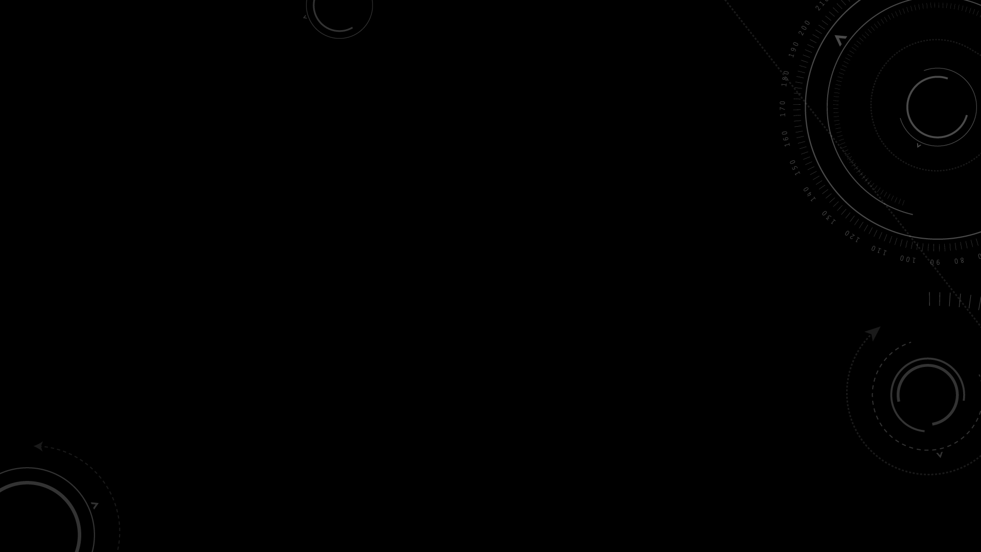
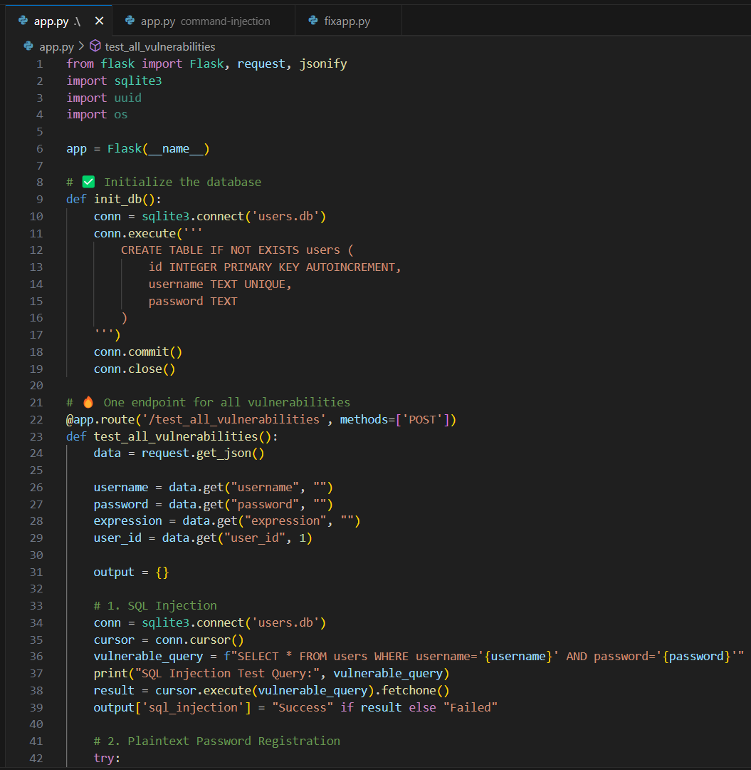
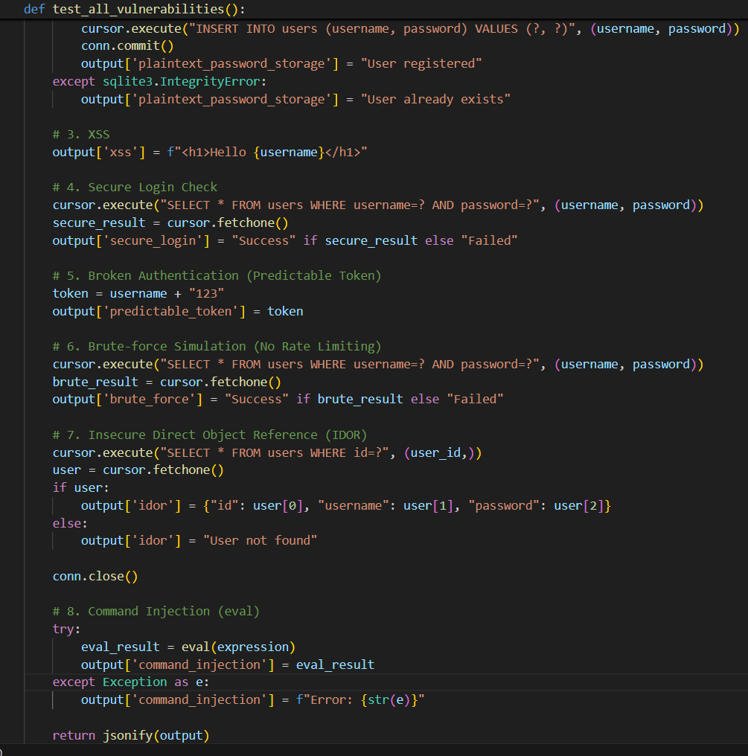

Slide 9
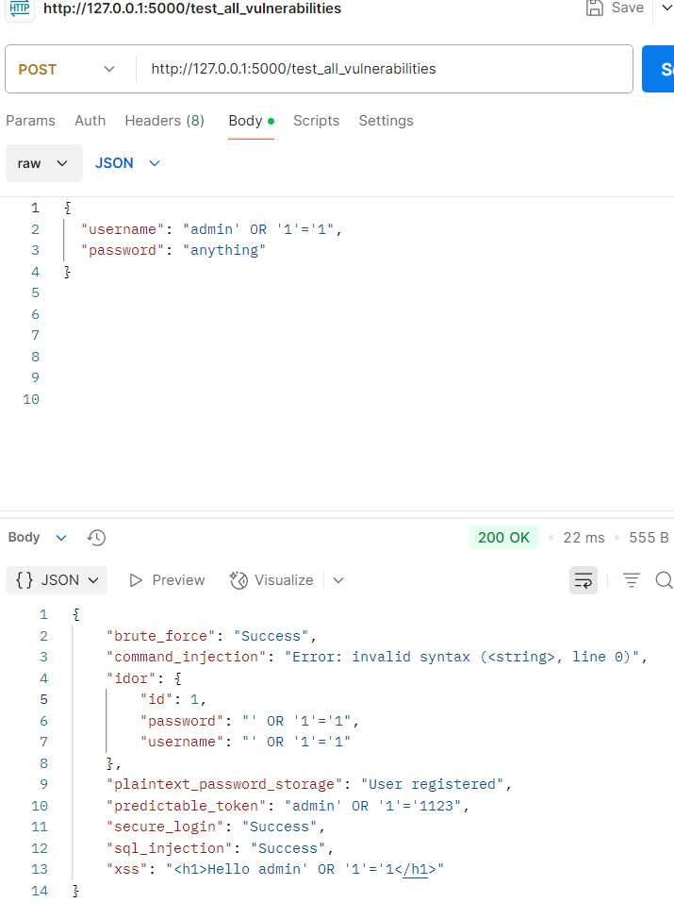
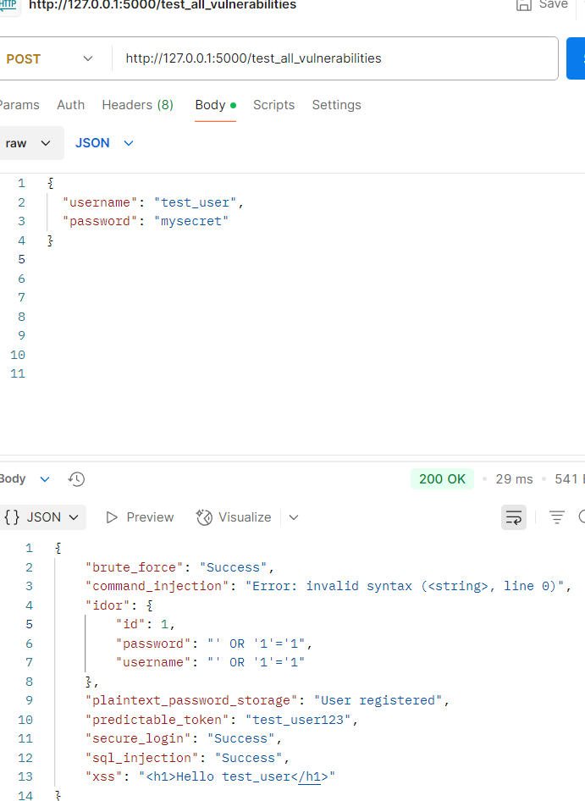
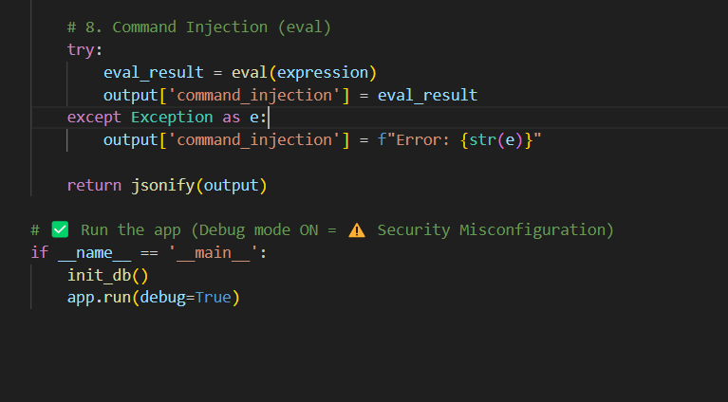

Slide 10
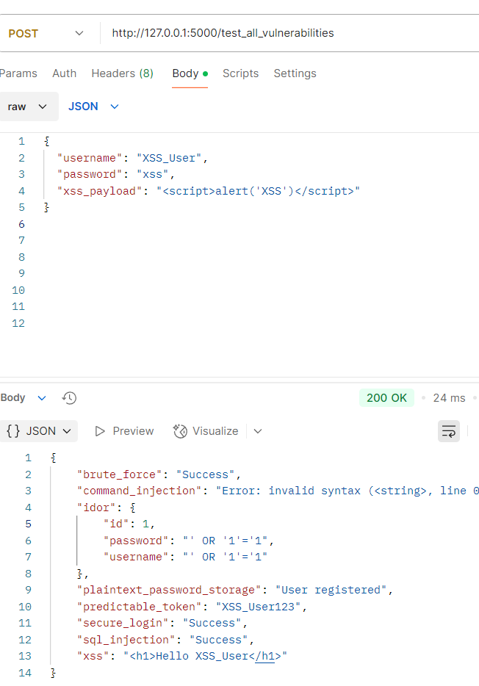
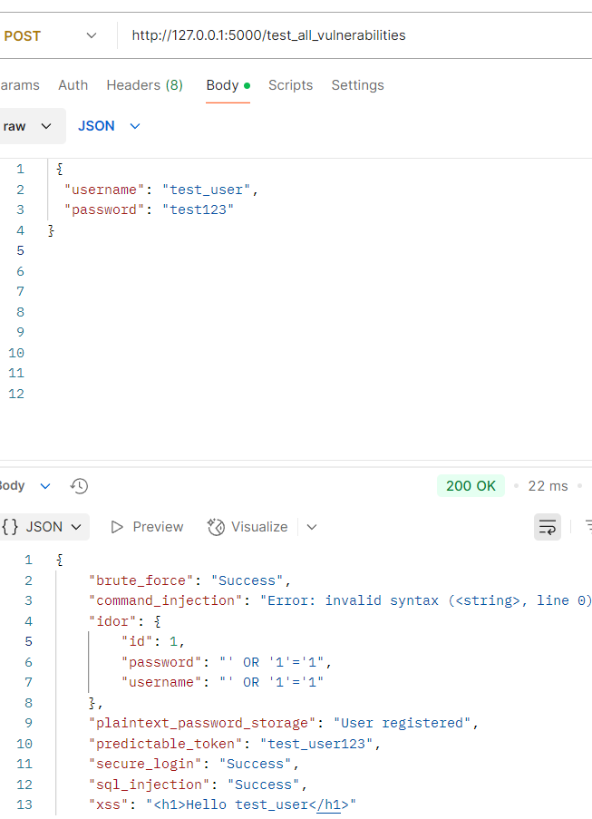
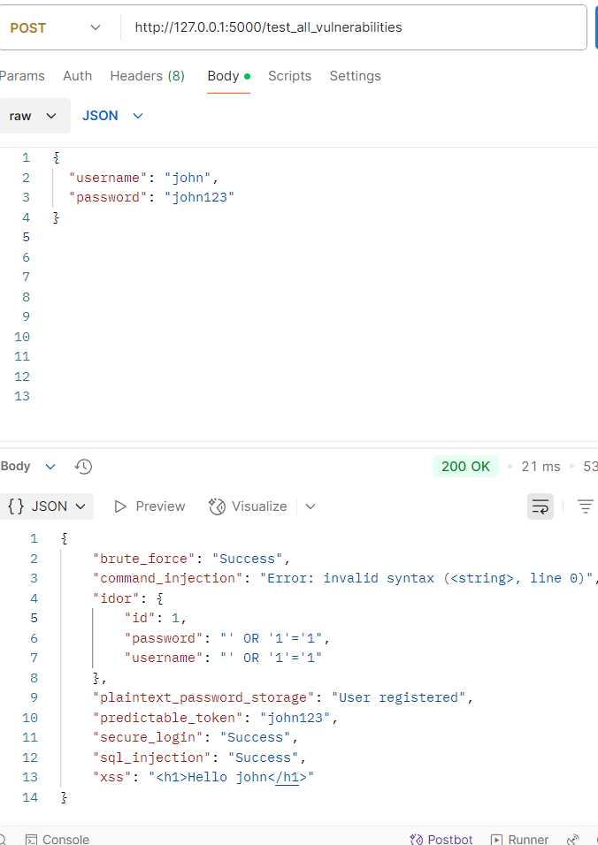

Slide 11
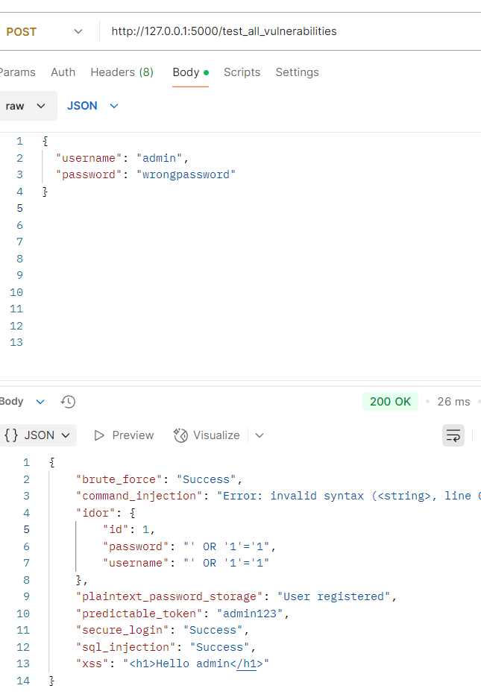
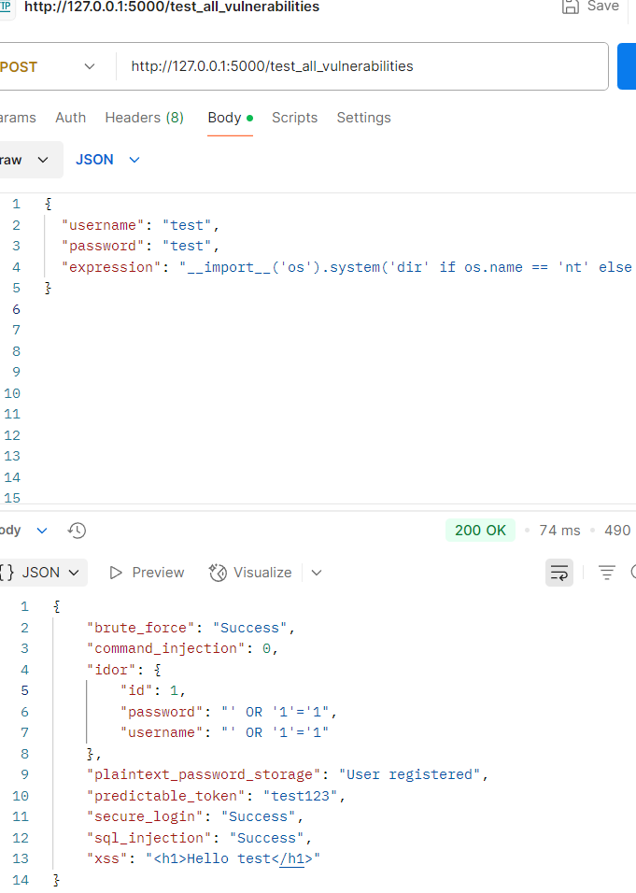
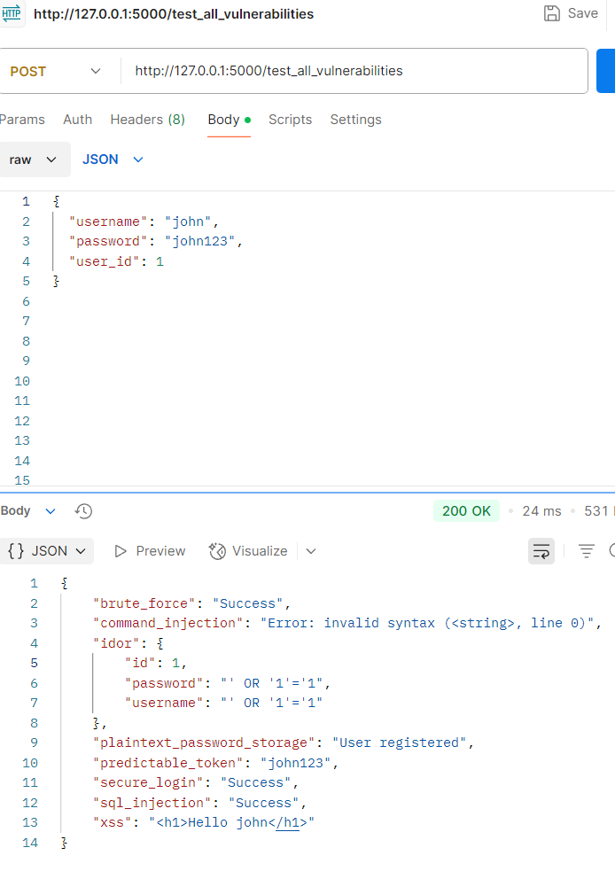

Slide 12
Specific Vulnerability - Command Injection (eval)
ALLOWED_COMMANDS = { "time": ..., "whoami": ..., "date": ... }
Only predefined safe commands are allowed.
eval is removed.
Prevents arbitrary command execution.
FIXED CODE FOR COMMAND INJECTION
You can see here a comparison of malicious payloads versus safe implementation.
Eval with user input → Dangerous.
Restricted functions → Safe.”

Slide 13
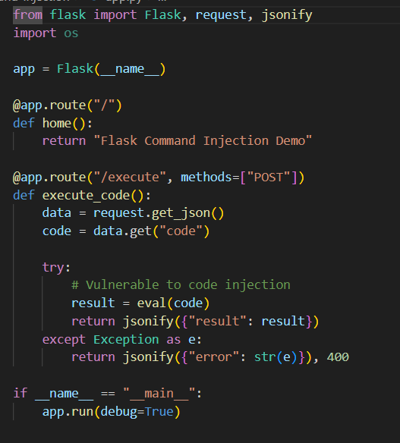
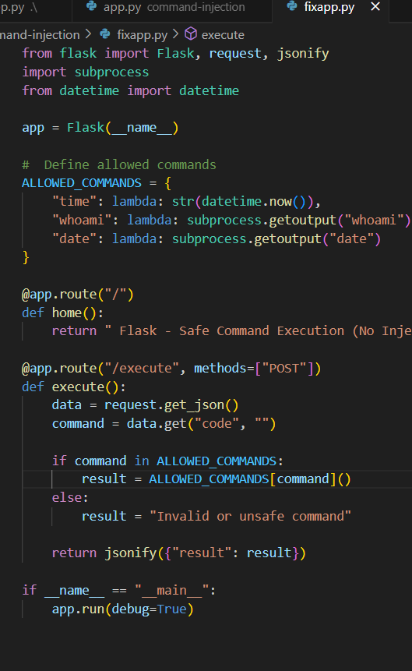
Specific Vulnerability - Command Injection (eval)
FIXED CODE FOR COMMAND INJECTION

Slide 14
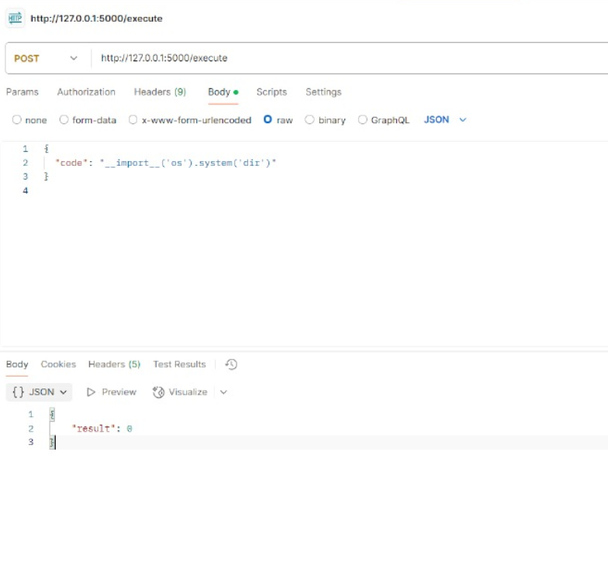
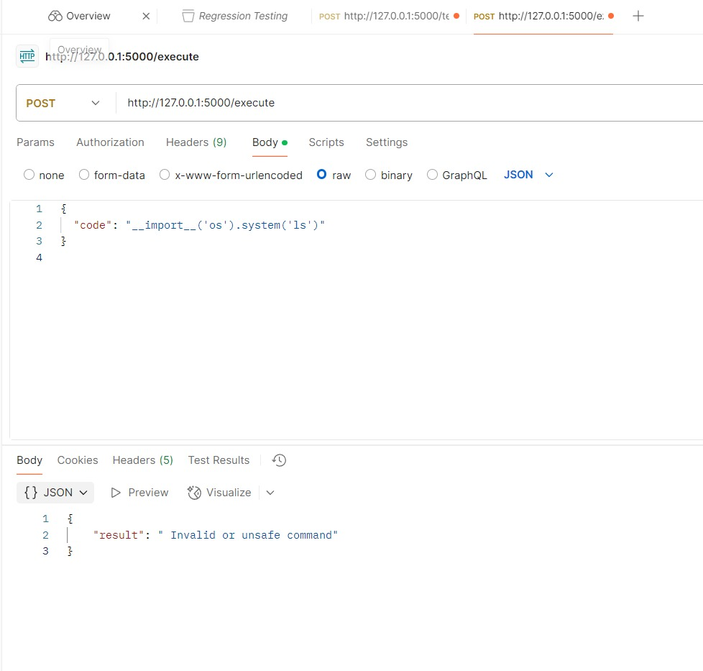
Specific Vulnerability - Command
Injection (eval)
Fixed code for Command Injection

Slide 15
Example Malicious Payloads:
Execute arithmetic:
01
{ "code": "5 * 3" }
Execute OS command:
02
{ "code": "__import__('os').system('whoami')" }
Execute subprocess command:
03
{ "code": "__import__('subprocess').getoutput('whoami')" }

Slide 16
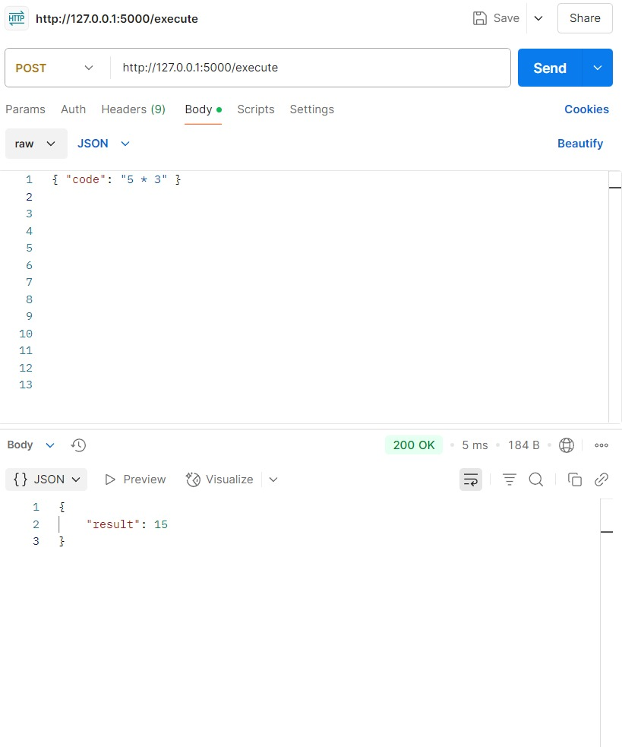
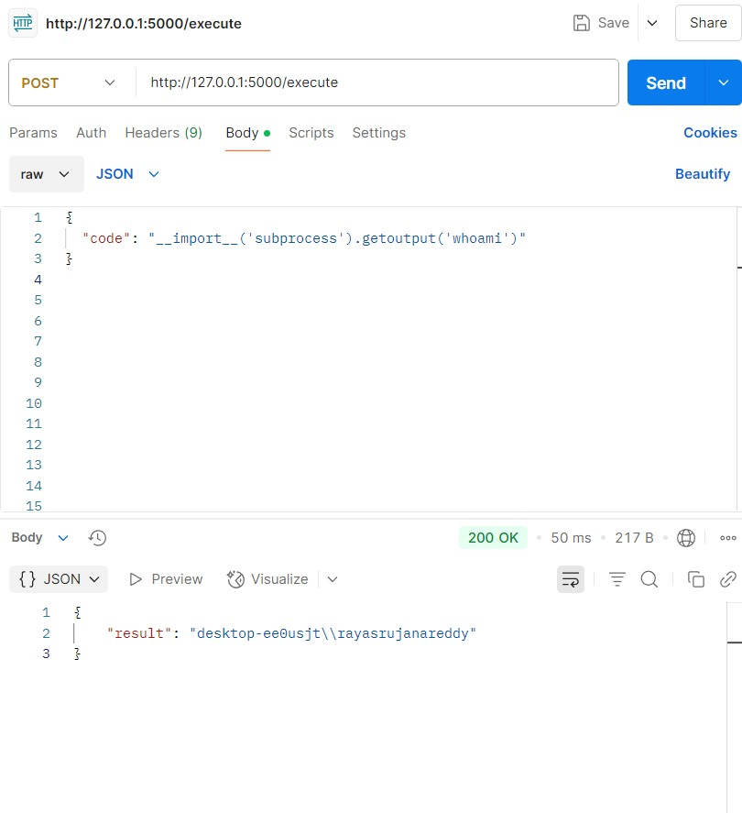
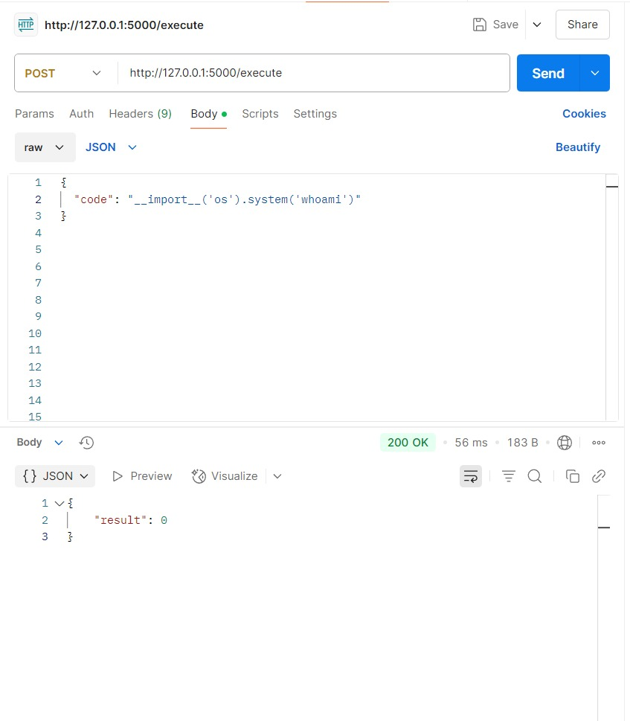

Slide 17
POST URL & API Endpoint
Base URL: http://localhost:5000/test_all_vulnerabilities
Use POST method
Content-Type: application/json
Command Injection Specific URL:
http://localhost:5000/execute
/test_all_vulnerabilities — for testing all flaws.
/execute —Specifically for command execution. This is where the eval() vulnerability was demonstrated and later fixed.

Slide 18
Conclusion
Demonstrated common web vulnerabilities
Conducted practical testing using crafted payloads
Learned secure coding practices
Fixed high-risk flaws like eval and plaintext passwords

